Slide 1
Asset and Goods market

Slide 2
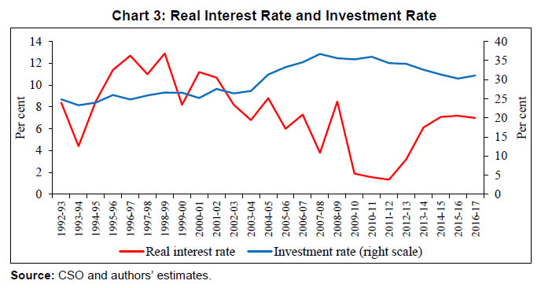
Money play an important role in an economy
Interaction of goods and asset market

Slide 3
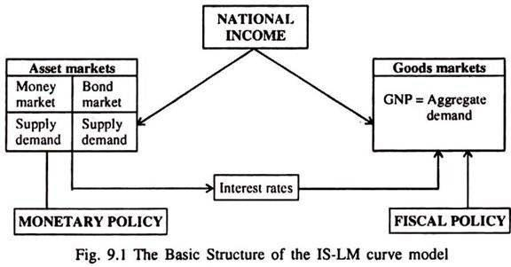
We introduce IS-LM Model
Interest rate as an additional determinant of AD

Slide 4
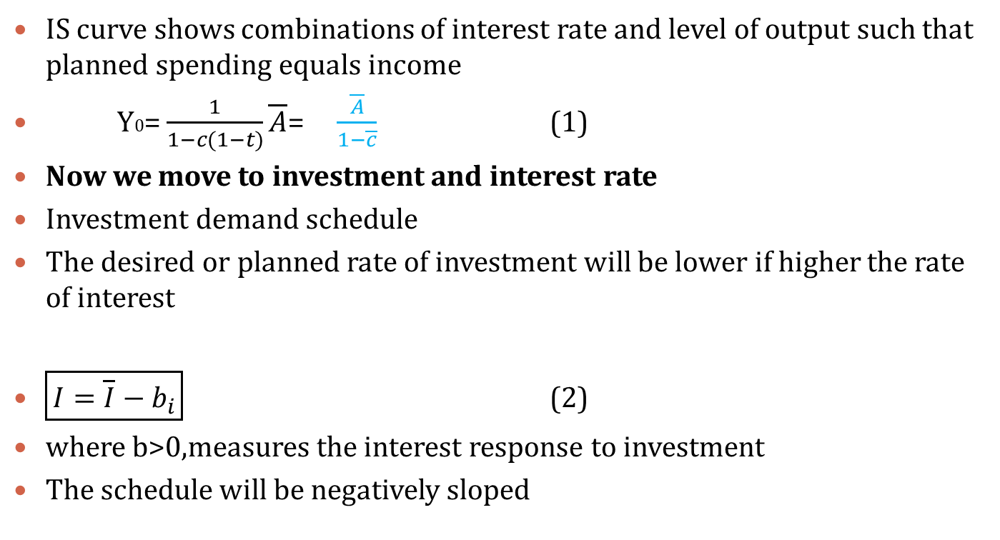
Goods market equilibrium and IS curve
IS curve shows combinations of interest rate and level of output such that planned spending equals income
Y0= $\frac{1}{1−c(1−t)}\overline{A}$= $\frac{\overline{A}}{1−\overline{c}}$ (1)
Now we move to investment and interest rate
Investment demand schedule
The desired or planned rate of investment will be lower if higher the rate of interest
$\boxed{I=\overline{I}−b_{i}}$ (2)
where b>0,measures the interest response to investment
The schedule will be negatively sloped

Slide 5
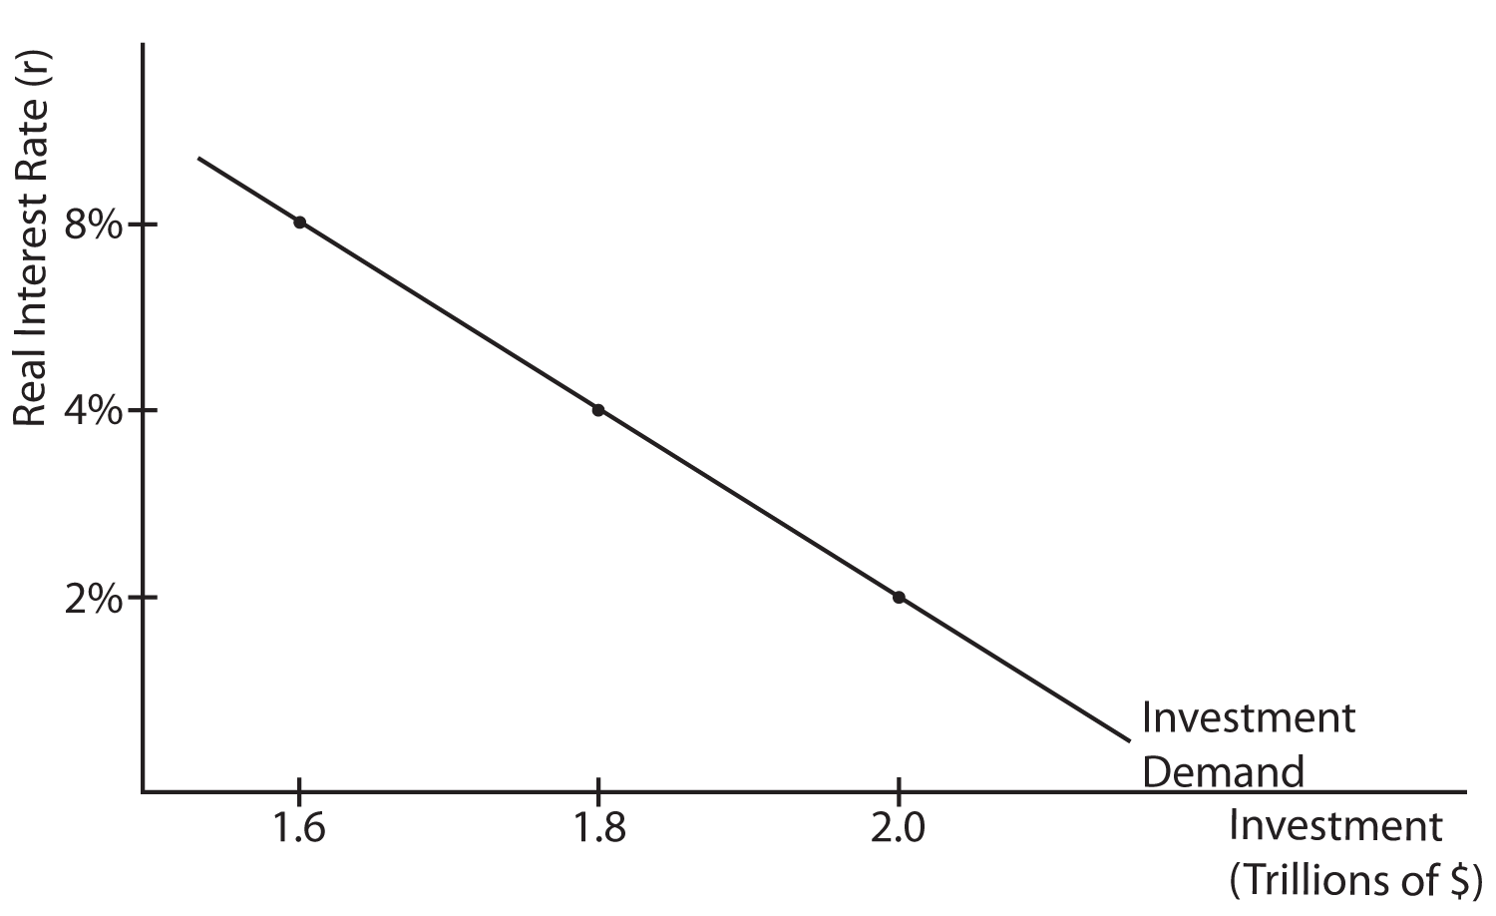

Slide 6

The interest rate, AD: IS curve (modification)
We now modify the previous AD function
AD= C+ I+ G (3)
$=c\overline{TR}+c\left(1−t\right)Y+\overline{I}−b_{i}+\overline{G}$
= $\overline{A}+\overline{c} Y−b_{i}$
Where $\overline{A}$ =$c\overline{TR}$+$\overline{I}$+$\overline{G}$
Higher i reduces investment spending and thus reduces income

Slide 7
Derivation of the IS curve

Slide 8
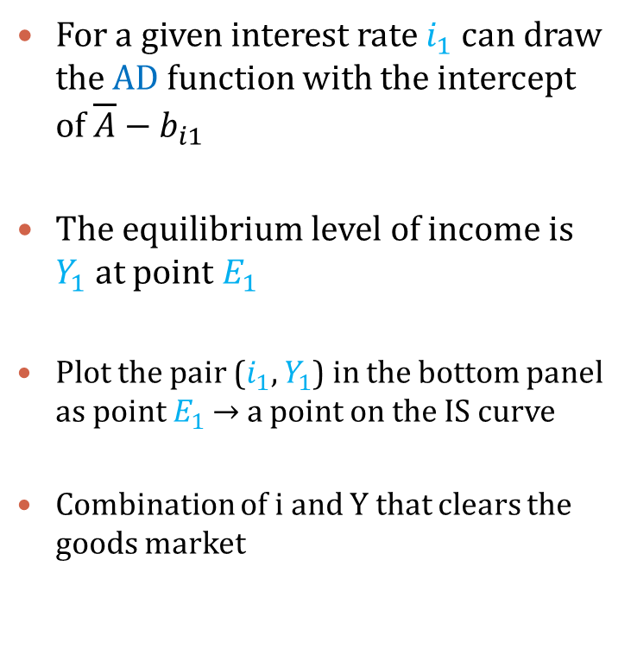
For a given interest rate $i_{1}$ can draw the AD function with the intercept of $\overline{A}−b_{i1 }$
The equilibrium level of income is $Y_{1}$at point $E_{1}$
Plot the pair ($i_{1}$, $Y_{1}$) in the bottom panel as point $E_{1}$ → a point on the IS curve
Combination of i and Y that clears the goods market

Slide 9
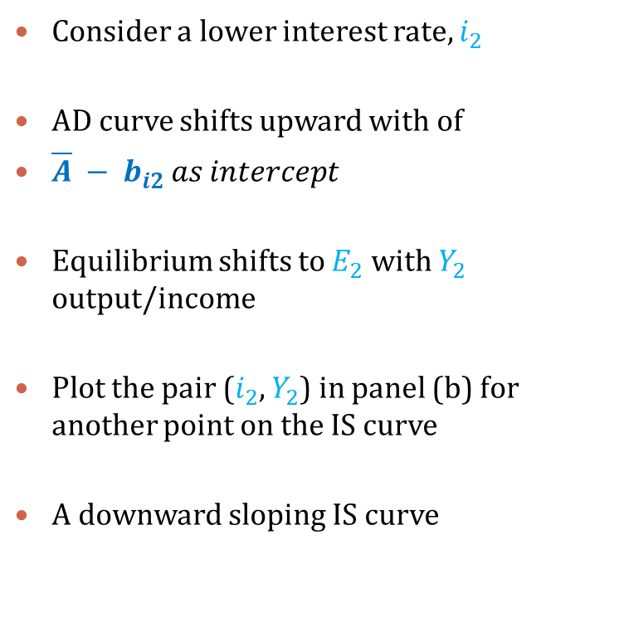
Consider a lower interest rate, $i_{2}$
AD curve shifts upward with of
$\overline{A} − b_{i2 }as intercept$
Equilibrium shifts to $E_{2}$ with $Y_{2}$ output/income
Plot the pair ($i_{2}$, $Y_{2}$) in panel (b) for another point on the IS curve
A downward sloping IS curve

Slide 10
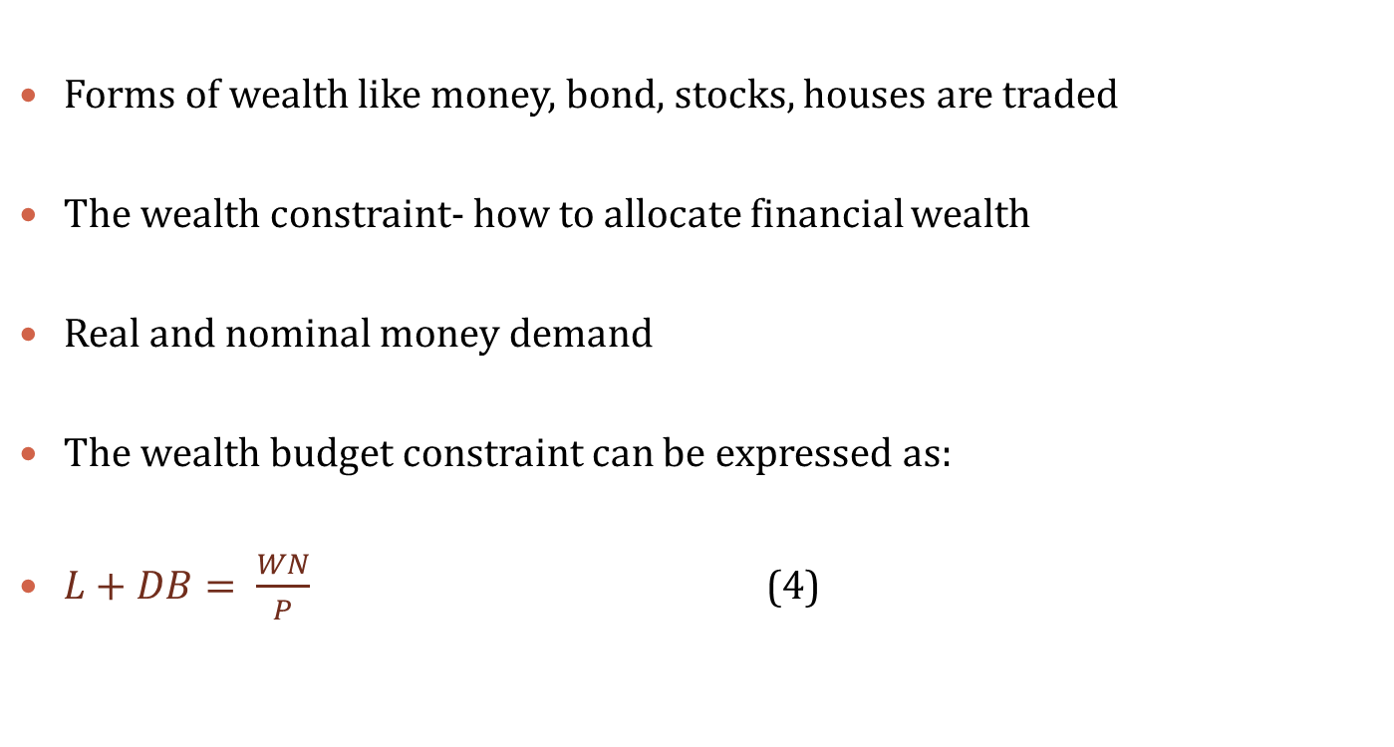
The Asset markets and the LM curve
Forms of wealth like money, bond, stocks, houses are traded
The wealth constraint- how to allocate financial wealth
Real and nominal money demand
The wealth budget constraint can be expressed as:
$L+DB= \frac{WN}{P}$ (4)

Slide 11
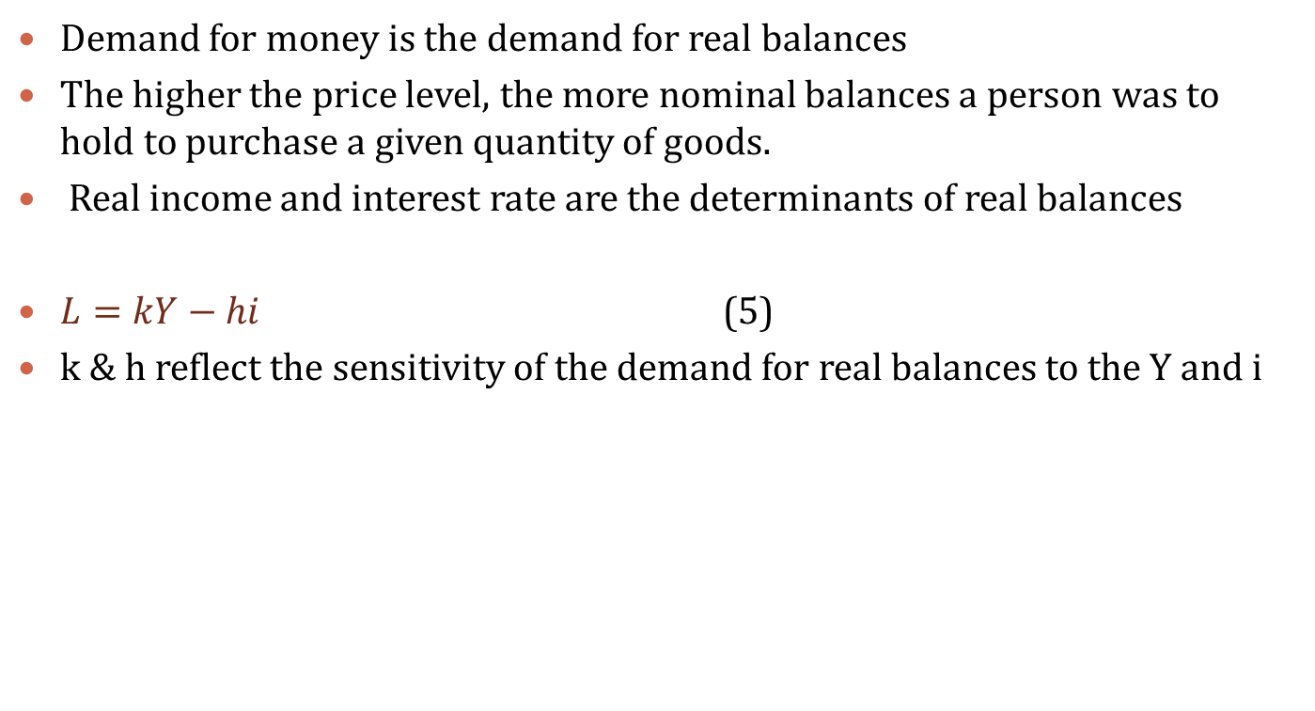
The demand for money
Demand for money is the demand for real balances
The higher the price level, the more nominal balances a person was to hold to purchase a given quantity of goods.
Real income and interest rate are the determinants of real balances
$L=kY−hi$ (5)
k & h reflect the sensitivity of the demand for real balances to the Y and i

Slide 12
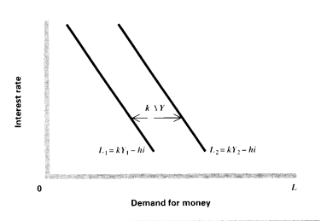
The demand for money

Slide 13
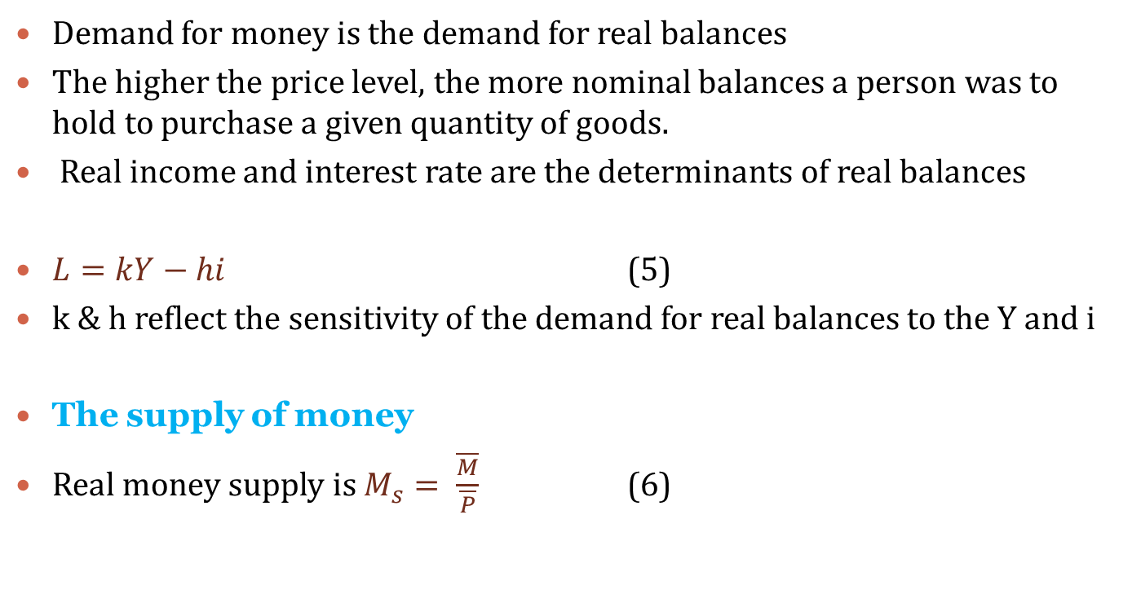
The demand for money
Demand for money is the demand for real balances
The higher the price level, the more nominal balances a person was to hold to purchase a given quantity of goods.
Real income and interest rate are the determinants of real balances
$L=kY−hi$ (5)
k & h reflect the sensitivity of the demand for real balances to the Y and i
The supply of money
Real money supply is $M_{s}= \frac{\overline{M}}{\overline{P}}$ (6)

Slide 14
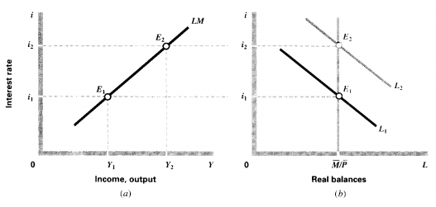
Derivation of LM curve

Slide 15

Money market equilibrium
$\frac{\overline{M}}{\overline{P}}=kY−hi$ (7)
Solving for the interest rate
$i=\frac{1}{h}(kY−\frac{\overline{M}}{\overline{P}}$) (8)

Slide 16
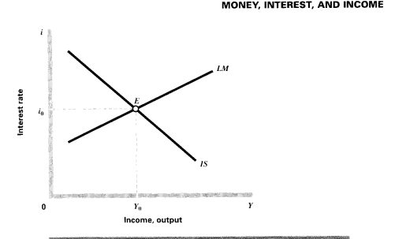
Equilibrium in the goods and money market

Slide 17
Consider an aggregate demand model (a simple economy), as the consumption function is given by C=100+0.65Y, while the investment is given by I= 80.
a. What is the equilibrium level of income?
b. What is the level of saving in equilibrium?
c. If, for some reason output were at the level of 750, what would the level of involuntary inventory accumulation be?
d. If ‘I’ were to rise 90, what would the effect be on equilibrium income? e. Compute the value of α

